Slide 1
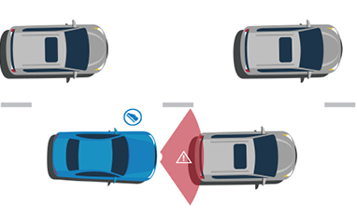
Vehicle Accident Warning System

Slide 2
INTRODUCE OURSELVES
Md.Nazmus Sadat
2018200000012
Ratul Bormon Protike
2015100000011
Noor-E Jannat Monisha
2016000000132

Slide 3
INTRODUCTION
This is an Arduino based Vehicle accident warning system. This kind of system is the fastest growing safety feature in automotive industries .Such a system enables vehicles to identify the chances of accident and give visual and audio warning to driver.So that the driver can take necessary action to avoid accident.

Slide 4
ABSTRACT
Vehicle accident warning system warn you of an impending collision by detecting stopped or slowly moved vehicles ahead of opponent vehicle. If there is an impending collision, the system will warn the danger using lights, beeps.

Slide 5
SYSTEM COMPONENTS
Arduino UNO
HC-SR04 Ultrasonic Module
Buzzer
10kohm Potentiometer
16x2 LCD Display
Resistor
Red LED
Yellow LED
Breadboard

Slide 6
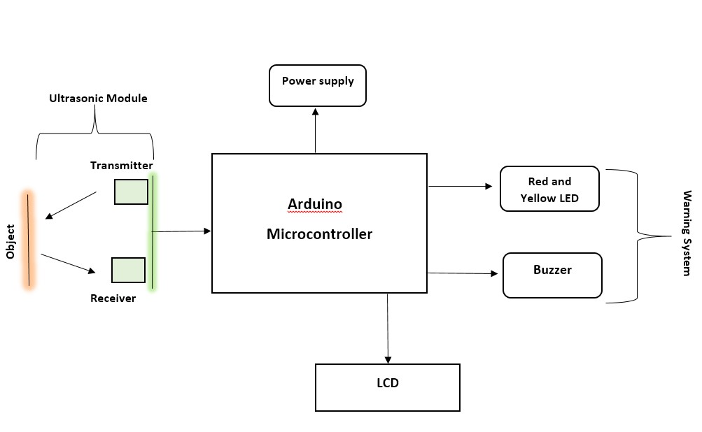
SYSTEM BLOCK DIAGRAM

Slide 7
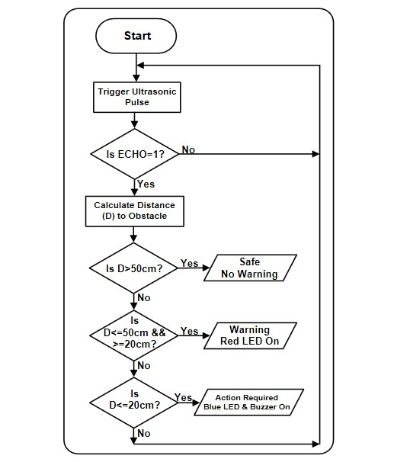
SYSTEM FLOW CHART

Slide 8
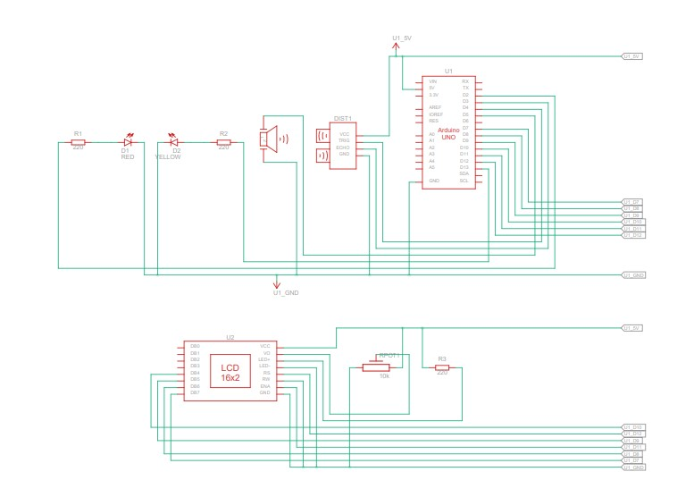
SYSTEM CIRCUIT DIAGRAM

Slide 9
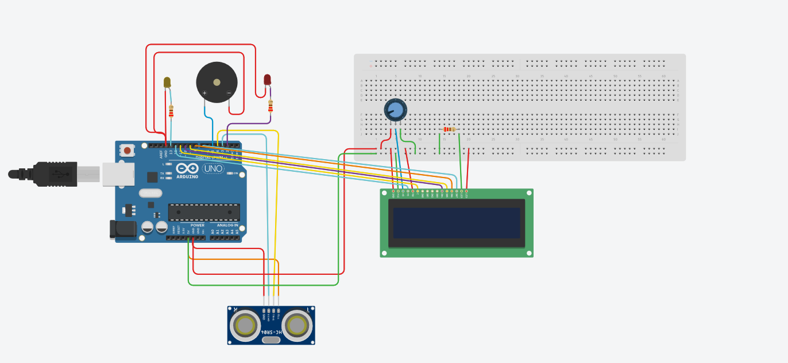
SYSTEM SIMULATION CIRCUIT

Slide 10
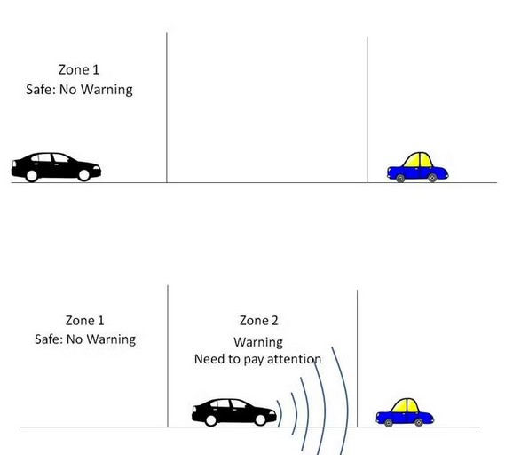
HOW THIS SYSTEM WORKS

Slide 11
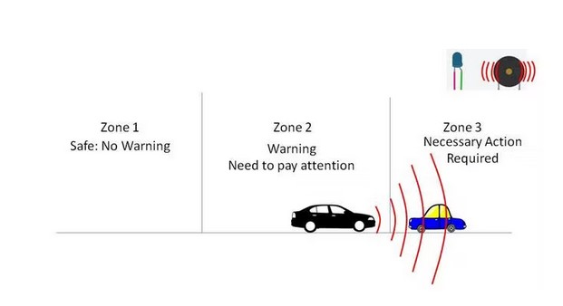
Zone 1: No warning. Zone 2: Only visual warning in this zone driver has to pay attention. Zone 3: Both visual and audio warning. Driver has to take necessary action to avoid accident.

Slide 12
ADVANTAGES
The systems are able to sense other vehicles and road users, including cyclists or objects near the vehicle. Audio and visual alerts help drivers to avoid potential crashes.
Forward crashes
Lane departure

Slide 13
FUTURE PLAN FOR THIS PROJECT
GPS tracking system
Using WIFI module

Slide 14
CONCLUSION
Vehicle accident warning system is designed a very simple and easily understandable model. The sensor can read distances that are at shorter range accurately. There were differences in the expected distance and measure distance but the system is safe.

Slide 15
THANK YOU

